Slide 1

HokieGuiDe
By: Peter Do, Rami Ghaleb, Kirti Dahal, Gaston Medrano-Frias, Marucs Huynh, Kyle Chau (Group 10)

Slide 2
Introduction to HokieGuide
HokieGuide is a one-stop shop for any resources a student may need while enrolled at Virginia Tech
AI-powered features to ensure a smooth and comprehensive college experience such as course recommendations, course difficulty, career guidance, and final grade prediction
Aids students in course registration by allowing access to wait-list positions, setting up meetings with advisors, and notifications for add/drop deadline and class registration status
Streamlines financial information with a scholarship application tracker, and a system to check tuition balance and payments
Assists students to excel in their classes with an assignment tracker, office hour information site, and exam schedule retrieval

Slide 3
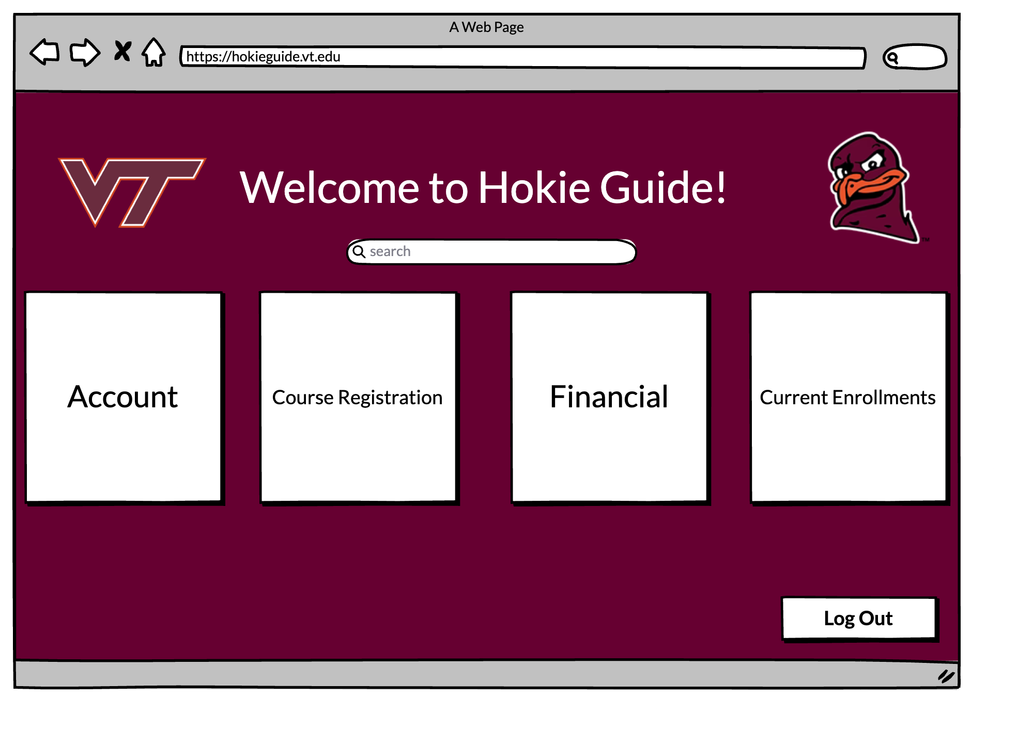
Hokieguide home page

Slide 4
Most Appealing Features
HokieGuide has a plethora of appealing features that could prove helpful and useful to a lot of students, including but not limited to:
Course difficulty estimation
AI-Powered career guidance
AI Grade prediction
Course Recommendations
Note: a number of these features utilize AI, which provides a more personalized experience for students

Slide 5
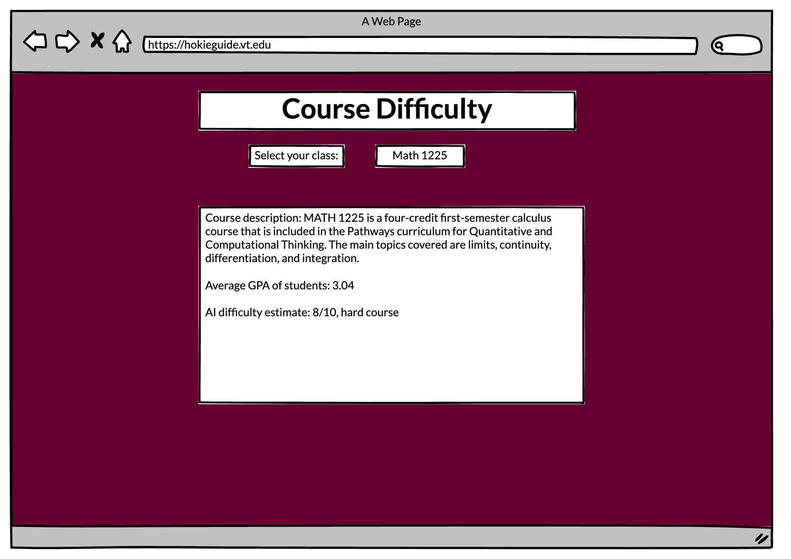
Estimating Course Difficulty
Uses AI to analyze several statistics regarding the course, such as the drop rate, GPA distribution, and course level
An estimate of the difficulty will be generated based on these statistics
Some factors will be weighted more than others when the AI determines the difficulty. Ex. GPA distribution > course level

Slide 6
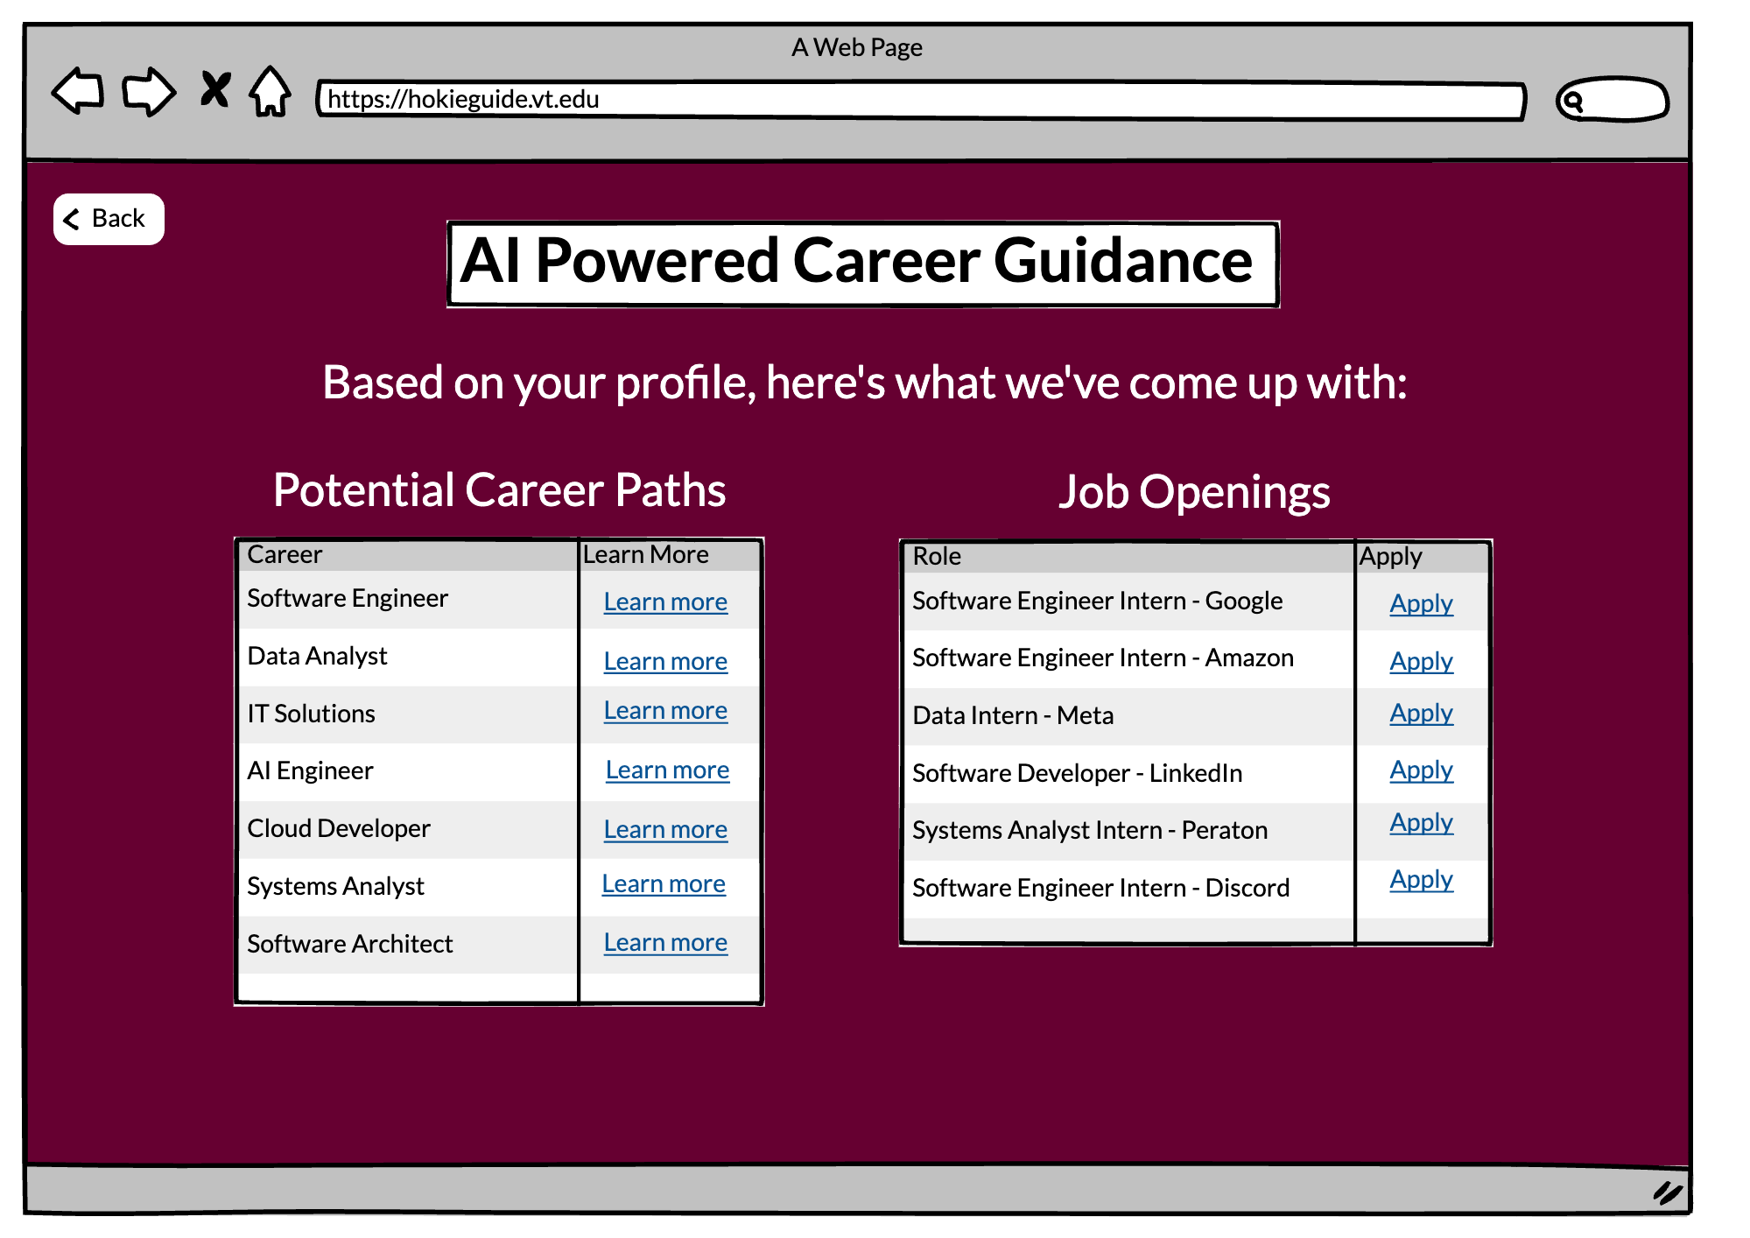
Ai Powered Career Guidance
Uses AI to recommend some potential career paths based on information from the student's profile (classes taken, major, etc.)
Also searches for jobs that are currently open on the web that match the student's profile
Upon clicking the links, users will be taken to a website that provides more insight on the potential career, or a website to apply for a role

Slide 7
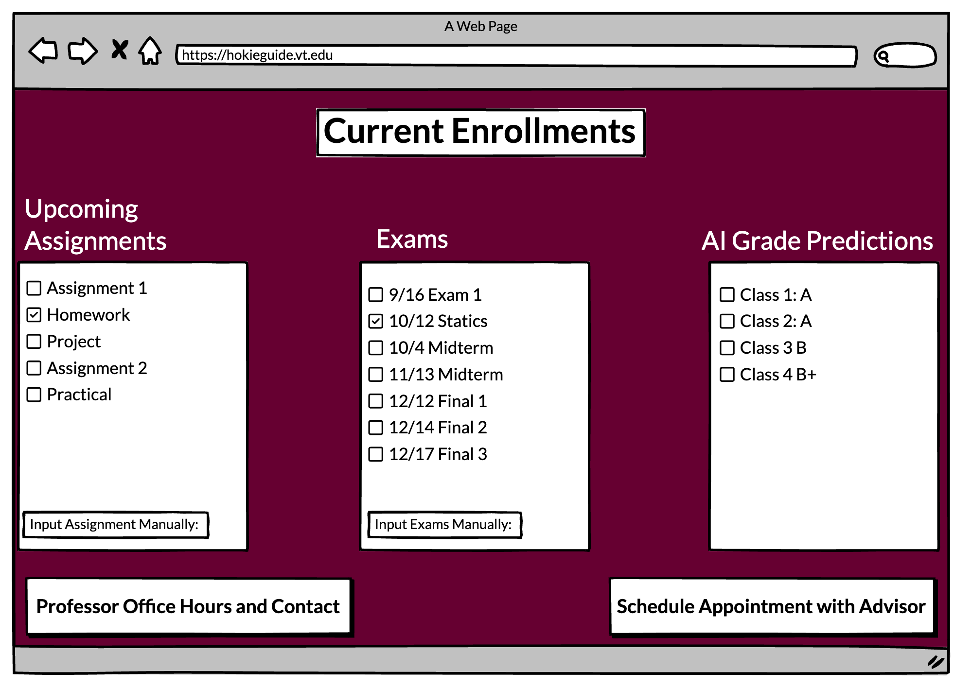
AI Grade Prediction
Analyzes student's current performance based on completed assignments, exams, and current grade (manual input also accepted)
Uses AI to predict the final grade on the class based on its analyzation and course grading criteria
Has buttons for the student to look at their professor's office hours as well as to contact their professor or advisor

Slide 8
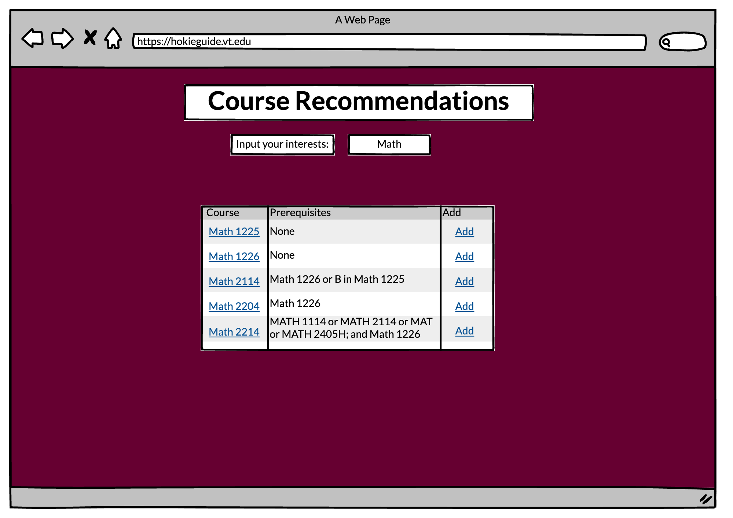
Course Recommendations
Uses AI to analyze information based off the student's academic performance/standing, course content, and student interest
Recommends courses to take based off this information with an add course link
Shows prerequisites to the course as well as giving a link to a webpage about the course content

Slide 9
Major Challenges/Limitations/Considerations
Accessing confidential User Data (Class Schedule, Financial Information, etc.)
Integrating external services such as GPA Distribution, Job Postings, Calendar
Scalability
User-friendly UI Design

Slide 10
Solutions
User inputs confidential data manually (through input fields or PDFs or transcripts, payments, etc.), then compare it to web-scraped data
Ensure the correct APIs are used to access other services and correct data is scraped
Implement scalable cloud infrastructure (AWS, Azure, etc.)
Created a more simplistic UI, and improved useability for the user

Slide 11
Lessons Learned
The Importance of Real-Time Validation
What Happened: Early in testing, mismatches between user inputs (like class schedules) and scraped data weren’t flagged immediately, causing user frustration.
Lesson: Implementing real-time validation (e.g., checking course data during add/drop as it’s uploaded) improved both user experience and app reliability.
Prioritizing Security from Day One
What Happened: Testing revealed vulnerabilities in storing and transmitting sensitive user data
Lesson: Security must be a priority from the start, with encryption, secure protocols, and regular audits to potential threats.
Handling Inconsistent Data Inputs
What Happened: PDFs and manual inputs had formatting issues, breaking validation against web-scraped data.
Lesson: We implemented robust data parsing tools and error handling systems, teaching us the importance of accounting for messy real-world data during development.

Slide 12
Summary
Purpose: A centralized platform to enhance students’ academic and personal growth through innovative tools and user-friendly features.
Highlights: Offers personalized assistance with academic planning, career exploration, and managing essential university tasks.
Innovation: Employs AI to provide tailored insights, recommendations, and support for a seamless college experience.
Development Takeaways: Focused on security, scalability, and usability to ensure practical implementation and user satisfaction.
Vision: To create an all-in-one solution that simplifies and enriches the student journey at Virginia Tech.

